Slide 1

ASEAN’s Diplomatic Response Thailand–Cambodia Border Conflict
From Non‑Interference to Proactive Peacekeeping
ASEAN Ministerial Meeting | December 2025
MD RAFID ABRAR MIAH
Research Officer, BIISS

Slide 2

Executive Summary
• Territorial and resource disputes along the 817 km border escalated into armed clashes in December 2025, triggering a humanitarian crisis. • At least 40 people were killed and over 750 000 were displaced, uprooting communities on both sides of the border. • ASEAN convened a Special Foreign Ministers’ Meeting on 22 Dec 2025 in Kuala Lumpur, signalling a departure from its non‑interference tradition. • U.S. and Chinese involvement underscored the need for Southeast Asia to balance external influences while maintaining autonomy.
750 k Displaced
40+
Fatalities
[1] [2] [3] [4]

Slide 3



Context & Challenges
Roots of Conflict
ASEAN’s Traditional Stance
• Unresolved border delimitation and territorial claims around key temples and resources
• Competition over access to land and water for farming and industry
• Militarised skirmishes and nationalist rhetoric inflame public sentiment
• Non‑interference and consensus limit rapid action on intra‑state disputes
• Focus has historically been on economic integration rather than security
• Absence of institutionalised mechanisms for conflict mediation
[1] [2]

Slide 4




ASEAN’s Evolving Role & Timeline
Dec 7–15
22 Dec
24 Dec →
Border clashes & 40+ casualties; 750 k displaced
ASEAN Special FMs Meeting in Kuala Lumpur; consensus to mediate
Ceasefire & mediation; U.S. pressure and China’s quiet diplomacy
[1] [2] [3]

Slide 5
Balancing Great‑Power Influence
US
China
ASEAN
High‑profile Pressure Public condemnations and demands for an immediate ceasefire emphasise Washington’s expectations. Political engagement is highly visible.
ASEAN Centrality Maintains autonomy while engaging both powers. Success hinges on balancing influences and presenting a unified Southeast Asian voice.
Quiet Diplomacy Beijing works through back channels and institutional ties to encourage de‑escalation, avoiding public grandstanding and offering face‑saving options.
[3] [4]

Slide 6


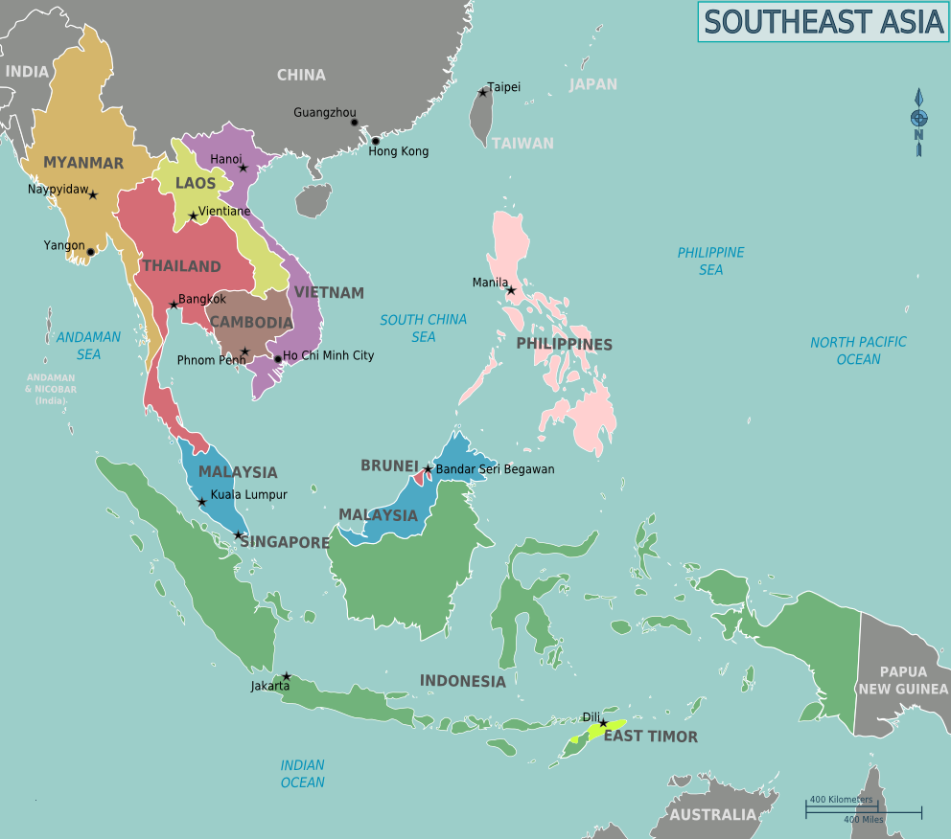

Humanitarian & Security Stakes
Humanitarian Crisis
• 750 k displaced across both countries
• Civilian casualties & trauma; families separated
• Calls for humanitarian corridors, shelters & medical aid
Security Risks
• Danger of escalation intao wider interstate war
• Potential involvement of great powers through proxies
• Disruption of regional trade routes & economic stability
[2] [3]

Slide 7

Regional Implications
Opportunities & Risks
Opportunities | Risks
Strengthen ASEAN’s credibility as a regional security actor | Failure undermines ASEAN’s legitimacy and invites further disputes
Demonstrate unity and centrality through joint crisis response | External powers could leverage divisions and tilt outcomes
Develop institutional mechanisms for conflict resolution & peacekeeping | Resource constraints may hamper sustained engagement
Enhance humanitarian cooperation and disaster response frameworks | Sets precedent of intervention that may be abused
[1] [3]

Slide 8

Analytical Insights & Normative Shifts
From Non‑Interference to Flexible Engagement
The crisis illustrates the necessity of moving beyond a strict non‑interference principle. ASEAN can adopt a “flexible engagement” model that allows early intervention when lives and regional stability are at risk.
ASEAN Centrality Requires Institutions
Informal diplomacy is insufficient for modern challenges. Developing standing conflict‑resolution bodies and rapid response mechanisms will make ASEAN’s centrality credible.
Balancing External Actors
Effective mediation demands managing major‑power influences without becoming a pawn. Transparency, inclusiveness and multilateral coordination are key.
Address Root Causes & Governance
Sustainable peace hinges on resolving underlying territorial disputes and improving border governance, ensuring equitable resource distribution and local consultation.
[1] [3] [4]

Slide 9




Recommendations & Way Forward
Institutionalise Conflict Resolution Establish a standing body within ASEAN for mediation, early warning and peacekeeping operations.
Scale Humanitarian Capacities Develop rapid deployment teams and logistics channels for shelter, medical aid and evacuation.
Maintain Strategic Autonomy Engage external powers transparently while safeguarding ASEAN unity and decision‑making.
Address Legal & Territorial Disputes Accelerate joint boundary demarcation, resource‑sharing agreements and impartial arbitration mechanisms.
Invest in People‑to‑People Ties Promote cross‑border cultural and economic exchanges to build trust and mutual understanding.
[3] [4]

Slide 10

Conclusion & Key Takeaways
• ASEAN’s decisive engagement in the Thailand–Cambodia crisis marks a turning point from passive observer to proactive peace broker. • Balancing external influence is essential – success depends on autonomy, unity and deft diplomacy. • Institutional reforms and addressing root causes will transform episodic mediation into sustainable peacekeeping. • Ultimately, turning crisis into credibility requires trust, empathy and concrete action.
From Crisis to Credibility
[1] [2] [3] [4]

