Slide 1

Trade Diversion or False Dawn?
Bangladesh's Rise over China in the U.S. Apparel Market: A Critical Methodological Reassessment
A Temporal and Comparative Analysis of U.S. Apparel Imports, 2025-2026
Author: Md Rafid Abrar Miah
Date: April 22, 2026

Slide 2

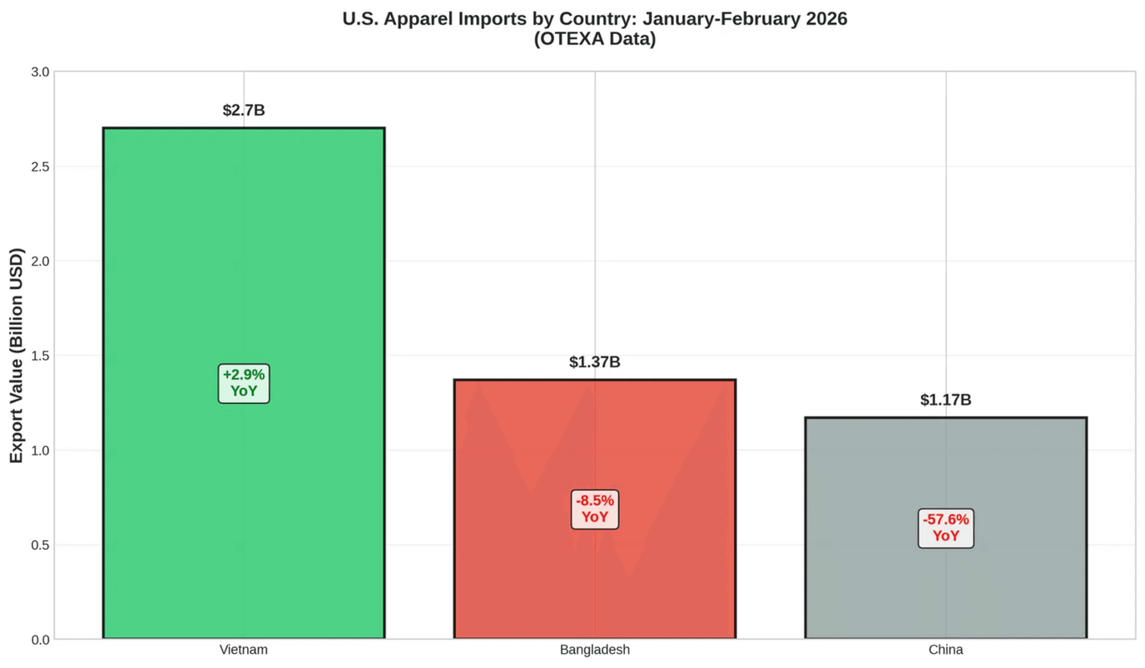
Conventional narrative: U.S. tariffs on China have successfully diverted trade to tariff-exempt Bangladesh.
Bangladesh Surpasses China in U.S. Apparel Exports—But the Story is More Complex
Critical methodological challenge: Apparel supply chains operate with 14–26-week lead times from order to U.S. port arrival.
A two-month snapshot in isolation risks conflating temporary order reallocations with sustainable structural shifts.
This analysis disaggregates temporal dimensions, reverse-engineers production timelines, and comparatively analyzes structural resilience.
January-February 2026 OTEXA data: Bangladesh $1.37B (↑ to #2), China $1.17B (-57.65%), Vietnam $2.7B (#1).

Slide 3

Testing Trade Diversion Theory Requires Clear Temporal Boundaries
Jan-July 2025
1. Pre-Tariff Baseline
Before finalization of reciprocal U.S.-Bangladesh tariff regime and escalation of U.S. tariffs on Chinese apparel.
Jacob Viner's trade diversion theory: Discriminatory tariffs shift sourcing from efficient producers (China) to less efficient but tariff-exempt producers (Bangladesh, Vietnam).
■
Aug-Dec 2025
2. Post-Tariff Transition
Immediate aftermath of policy shock; buyers begin adjusting sourcing strategies.
■
Empirical test requires isolating the tariff shock from pre-existing trends.
■
Without temporal disaggregation, causal attribution is methodologically flawed.
Jan-Feb 2026
3. OTEXA Data Period
Current snapshot reflecting goods ordered during the transition period.
■
We must divide the analysis into three distinct periods to accurately assess the impact of U.S. tariffs on Chinese apparel.

Slide 4
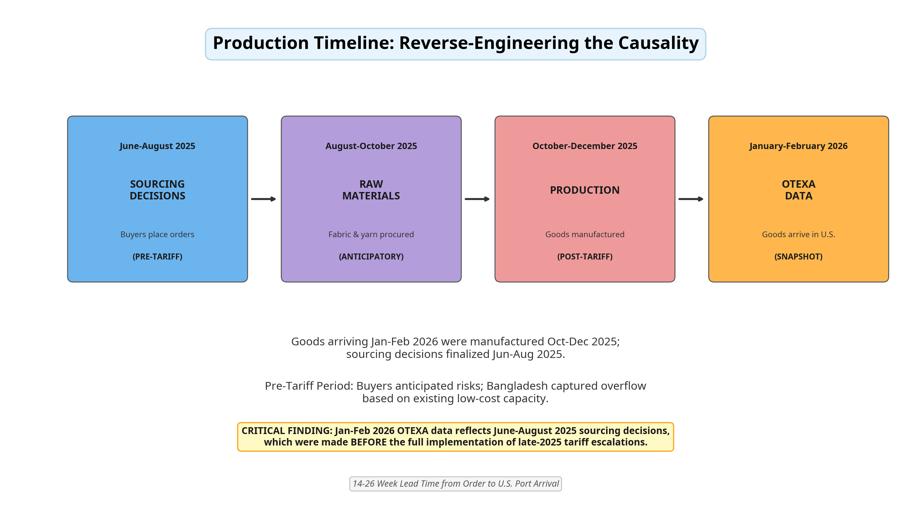
Goods arriving Jan-Feb 2026 were manufactured Oct-Dec 2025; sourcing decisions finalized Jun-Aug 2025. Pre-Tariff Period: Buyers anticipated risks; Bangladesh captured overflow based on existing low-cost capacity.
Conclusion: Attributing Bangladesh's rise strictly to finalized tariffs is a temporal fallacy; current data reflects anticipatory shifts.

Slide 5
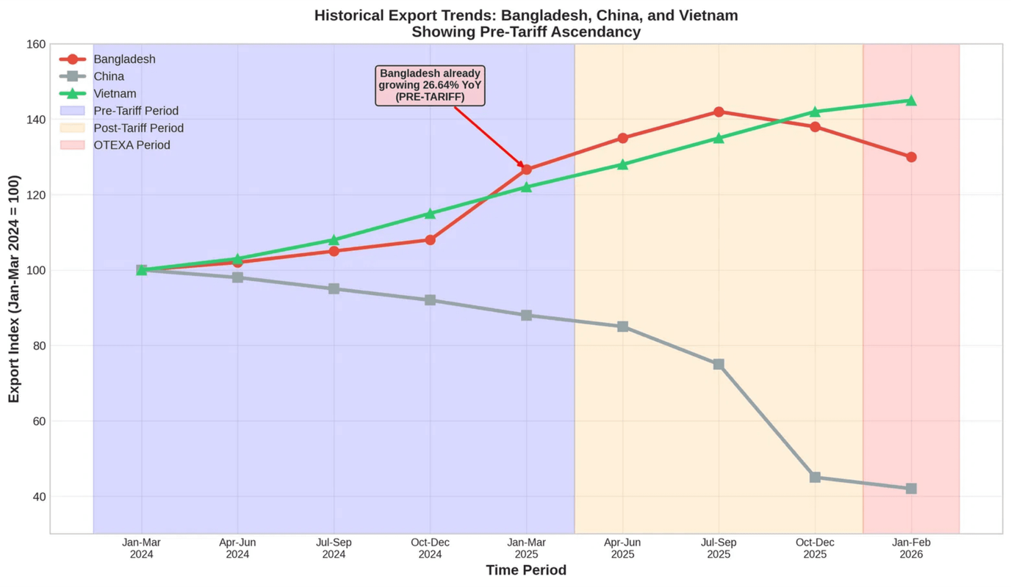
Bangladesh Was Already Growing Before the Tariff Shock
January-February 2026 data represents continuation of pre-existing trajectory, not sudden tariff-induced inflection point.
Tariffs acted as accelerant to existing trend, not primary catalyst.

Slide 6
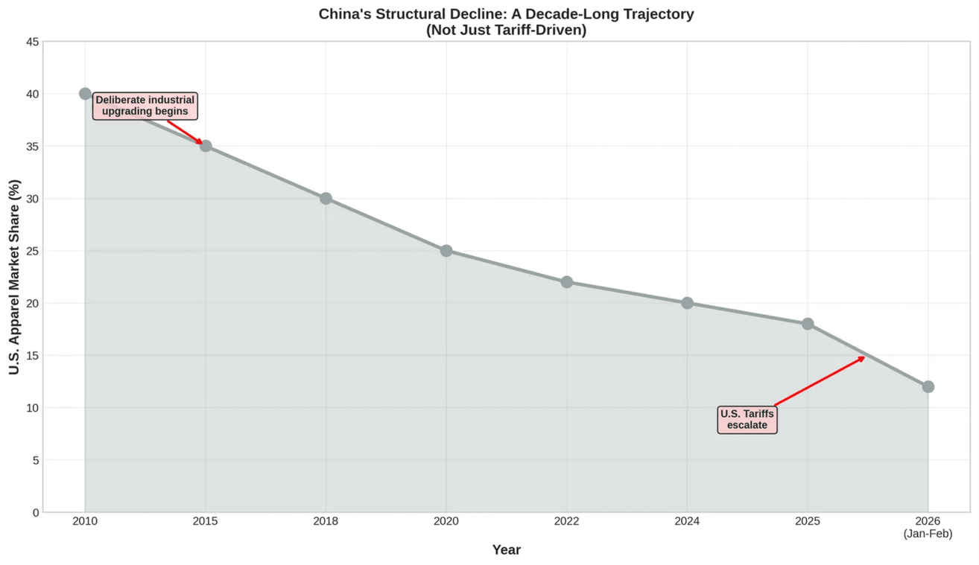
Dual Reality: China's 57.65% Export drop reflects both punitive tariffs and China’s strategic pivot. The decline is primarily structural, not solely tariff-driven.
Steady Decline: 40% (2010) → 20% (2024) → 12% (2026) (Approx Value)
Tariffs accelerated an existing exodus from apparel assembly.

Slide 7
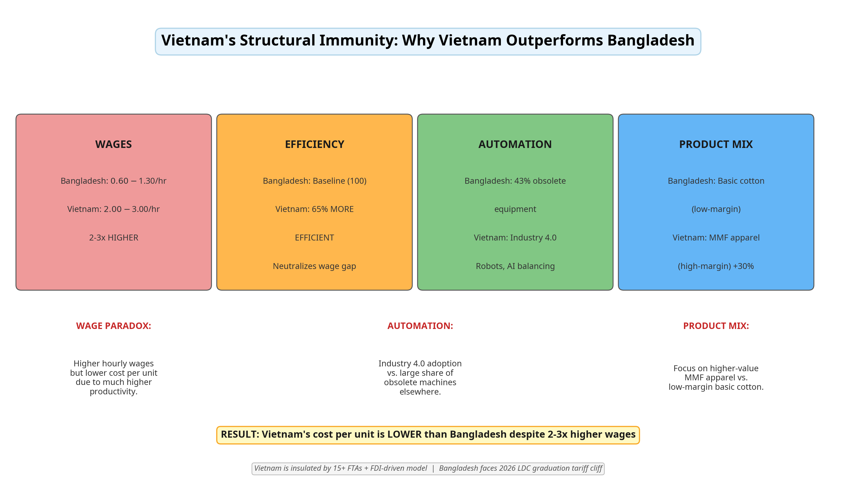
WAGE PARADOX: Higher hourly wages but lower cost per unit due to much higher productivity.
AUTOMATION: Industry 4.0 adoption vs. large share of obsolete machines elsewhere.
Product mix: Focus on higher‑value MMF apparel vs. low‑margin basic cotton.

Slide 8
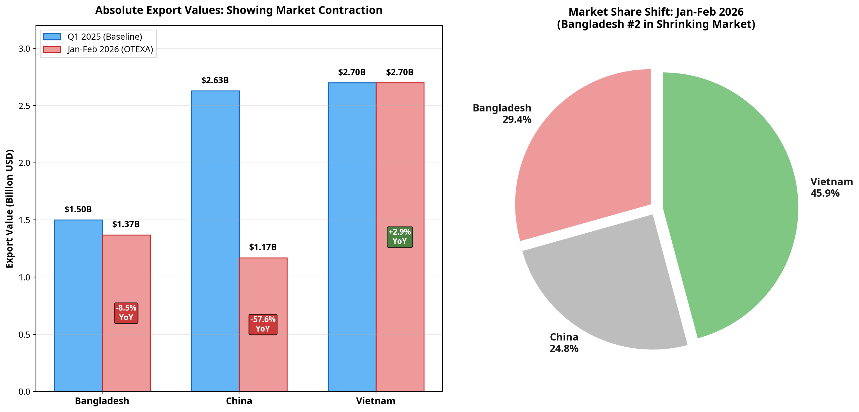
Bangladesh Achieved #2 Position While Its Exports Declined 8.53% Year-on-Year
Reality: Bangladesh shrank slower than China — a relative, not absolute, gain.
U.S. apparel imports contracted ~13.5% in the period.

Slide 9
Bangladesh's Apparent Advantage Will Evaporate Without Structural Reforms
Methodological Findings
Strategic Imperatives
Temporal Fallacy: Jan-Feb 2026 OTEXA data reflects pre-tariff sourcing, not tariff reaction.
MMF Backward Linkage: Establish innovation funds for domestic synthetic fiber production.
■
■
Automation Adoption: Implement technology leasing programs and training institutes.
Market Contraction: Bangladesh's rise to #2 is relative to a shrinking market (-13.47%).
■
■
Trade Architecture: Accelerate bilateral FTA negotiations with EU, UK, and Japan.
■
China's Pivot: China's decline is a decade-long structural shift, merely accelerated by tariffs.
■
Energy Infrastructure: Ensure reliable power supply for Industry 4.0 deployment.
■
Vietnam's Immunity: Vietnam outperforms due to structural superiority (efficiency, MMF, FTAs).
■
Conclusion: Trade diversion theory is partially validated, but Bangladesh's position is a temporary "false dawn."
Timeline Imperative: Bangladesh has a 24-month window to implement reforms before the 2026 LDC graduation tariff cliff.

Slide 10

References and Data Sources
[1] U.S. Office of Textiles and Apparel (OTEXA). "U.S. Imports of Textiles, Apparel, Footwear, Leather and Travel Goods: January-February 2026." U.S. Department of Commerce, April 2026.
[2] Viner, J. The Customs Union Issue. Carnegie Endowment for International Peace, 1950.
[3] Gereffi, G., & Frederick, S. "The Global Apparel Value Chain, Trade and the Crisis: Challenges and Opportunities for Developing Countries." World Bank Policy Research Working Paper, 2010.
[4] Sheng Lu. "Patterns of U.S. Apparel Imports: Updated January 2026." FASH455 Global Apparel & Textile Trade and Sourcing, 2026.
[5] Lu, S. "Why China Remains the Unrivaled King of Apparel Manufacturing." Just-Style, 2024.
[6] OECD. "OECD Economic Surveys: Viet Nam 2025." Harnessing Trade and Investment Flows to Boost Productivity, 2025.

